Slide 1

Introduction to Recommendation System
Safaeat Molla
Southeast University
Saturday, June 3, 2023

Slide 2






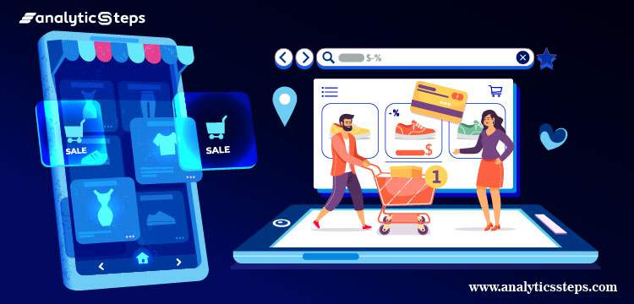
Agenda
Can know about Recommendation System.
Why we should learn Recommendation Sys.
What is the goal of this.
How many types and what are this.
Explanation of this methods.
Recommendation Techniques.
Saturday, June 3, 2023

Slide 3
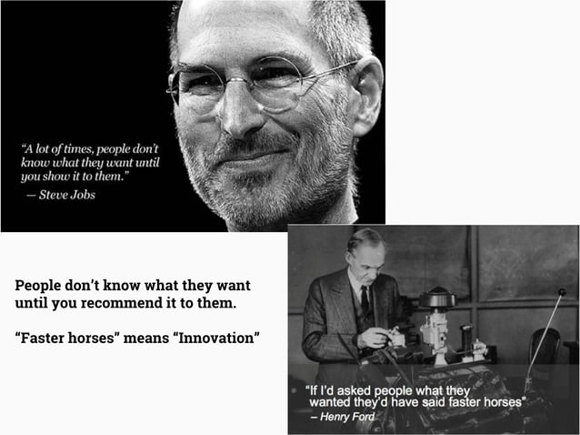
Saturday, June 3, 2023

Slide 4
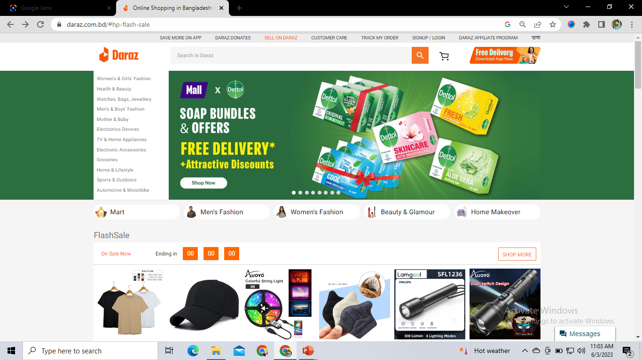

Slide 5
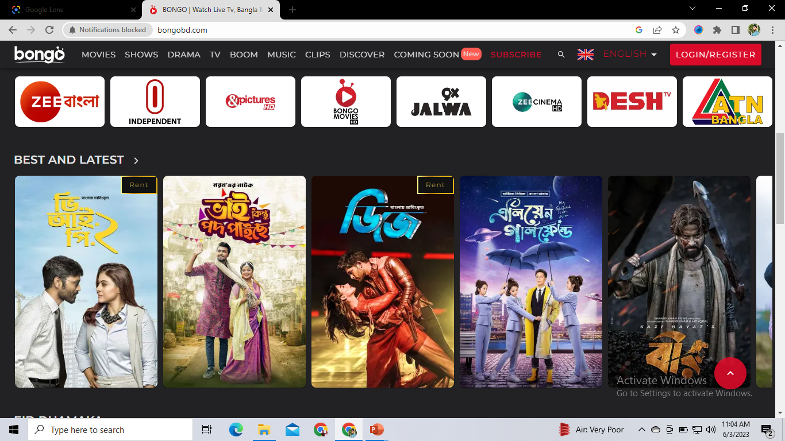

Slide 6
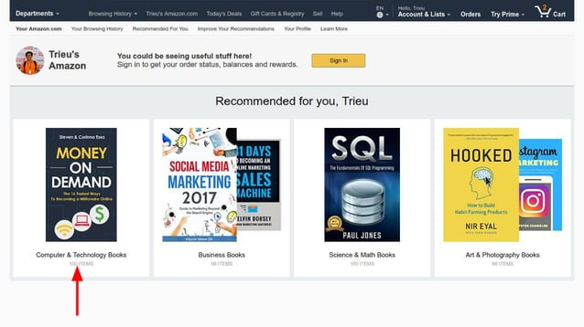

Slide 7

What is a Recommendation System?
Example:
YOUTUBE Video Suggest
- think when you are most of the time watch news documentary on YT, then you will see that, most of the time the YT will recommend you the new updates of news.
Related to-
NETFLIX Movie Recommendation
DARAZZ Product Recommendation
FOOD PANDA etc.
‘’A recommendation system is an information filtering technique, which provides users with information, which he/she may be interested in.’’
Saturday, June 3, 2023

Slide 8

Recommender systems
In technical terms, a recommendation is to develop a mathematical model or objective function which can predict how much a user will like an item.
If U = {users}, I = {items) then F = Objective function and measures the usefulness of item I to user U, given by: F: U * I → R
Where R = {recommended items).
For each user u, we want to choose the item i that maximizes the objective function:
u Є U, ${I′}_{u}$ = argma$x_{u}$u(u, i)
Saturday, June 3, 2023

Slide 9
Some other Examples
News (What to read now?)
Social sites (Which person to contact as friend?)
Vacations (Where to travel and what to see?)
Retailers (How much products to supply?)
Financial assets (loan, portfolio)
Advertisements etc.
Saturday, June 3, 2023

Slide 10
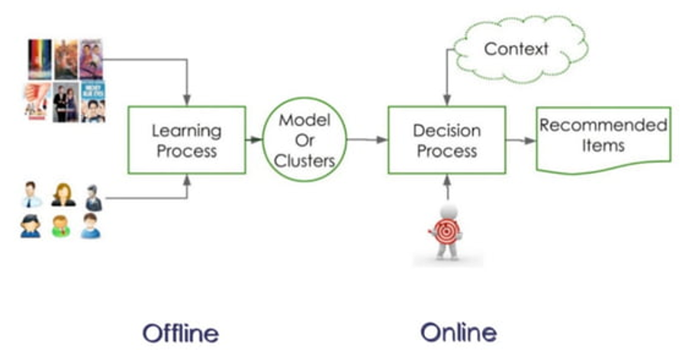
Process of recommender systems
Saturday, June 3, 2023

Slide 11
Who uses recommender systems?
Retailers and e-commerce in general
-Amazon, Netflix, etc.
Service sites, e.g. travel sites
Media organizations
Dating apps
Saturday, June 3, 2023

Slide 12
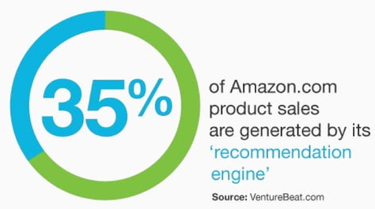
Why there is a need?
Information Overload
-Recommender systems help in addressing the information overload problem by retrieving the information desired by the user based on his or similar users' preferences and interests.
2. User Experience
Increase user satisfactions
Increase user fidelity
To enjoy the recommendation
3. Revenues
-To increase the number of items sold
Saturday, June 3, 2023

Slide 13
Goals and benefits of Recommender Systems
For the consumers (users)-
Helping the users to find useful contents to satisfy their needs.
Reducing the time of content searching.
Providing relevant information from the massive information flow.
Exploring new preferences, trust in recommender system.
For the business-
Improving business success indicators (or key performance indicators, KPI)
Increasing revenue, CTR, watching/listening duration
Increasing conversion rate and user engagement, reducing churn
Cross-selling, upselling, advertisement
2. Reducing popularity effect, less popular contents are also consumed
3. Promotions, targeting, campaign
Saturday, June 3, 2023

Slide 14
So, Recommendation System as a Software Agents/ User-
Items
User
Recommender
System
Recommend Item to User
Or User to Item.
Saturday, June 3, 2023

Slide 15
The problems of recommendation system
1. Cold start problem
-This occurs when a recommendation system struggles to provide accurate recommendations for new or less active users or items. Limited or no data about their preferences makes it challenging to generate relevant recommendations.
2. Data sparsity
-many users have rated or interacted with only a small fraction of the available items. This sparsity makes it difficult to accurately model user preferences and can result in suboptimal recommendations.
3. Popularity bias
4. Lack of serendipity (overlook contextual information such as time, location, or social context)
5. Limited context awareness…..etc.
Saturday, June 3, 2023

Slide 16
Areas of Use
Matches varying individual customers’ taste with a huge inventory
Product Dicovery
In E-store
Loyalty Programs
Recommendations for new products, up-sell cross-sell suggestions, and product discovery
Recommendations pertaining to specific program, suggestions for redemption and program upgrades
Recomm. System
Search
Email Campaigns
Order of search results on the store can be varied for each customer to aid product discovery
Bills and mailers
analyzed for recommending plans In E-store Search Loyalty Programs Product Recomm. Engines Email Campaigns Effectively
Whitespace can be used for cross-sell and up-sell Usage can be analyzed for recommending plans
Saturday, June 3, 2023

Slide 17
Recommendation types
1. Item to User
>Conventional recommendation task: You may like these items".
2. Item to Item
>Recommending items that are somewhat similar to the item currently viewed by the user
>Personalized or non-personalized similarity
3. User to User
>Recommending different users for the users based on metadata or activity
>Social recommendations (who to follow, who to connect) or similar users
4. User to Item
>Promoting items that the seller wants to sell to the most probable buyers (e.g. newsletters, notifications) >Who would buy this item?“
5. Group recommendations
> Recommending a group of items or users

Slide 18
In general, There are Two types of recommend. system
Personalized
Non-Personalized
Personalized recommend. System
“A personalized recommendation system is a type of algorithm or technology that suggests items or content tailored to an individual user's preferences and interests. It takes into account the user's past behavior, demographic information, and other relevant factors to generate personalized recommendations.”
Example: Netflix's recommendation system analyzes a user's viewing history, ratings, and interactions with the platform to provide personalized movie and TV show recommendations.
Saturday, June 3, 2023

Slide 19
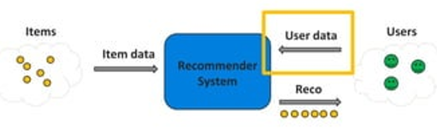
Personalized recommend. System Rules-
User data: Descriptive information about the users (e.g. age, gender, location)
Paradigm: Recommendations are calculated by predefined used data based rules
How: Setting item and user data-based rules (men between 45-55 → expensive cars)
Properties:
Semi-personalized
Requires manual work (eg rule constructing)
Interpretable
Saturday, June 3, 2023

Slide 20
Non-Personalized recommend. system
“A non-personalized recommendation system, also known as a popularity-based recommendation system, provides recommendations that are not personalized to individual users. Instead, it suggests popular or commonly chosen items to all users without considering their specific preferences or characteristics.”
Example: A non-personalized recommendation system on an e-commerce website might display "Best Sellers" or "Trending Products" sections, showcasing items that are popular among all users.
Saturday, June 3, 2023

Slide 21
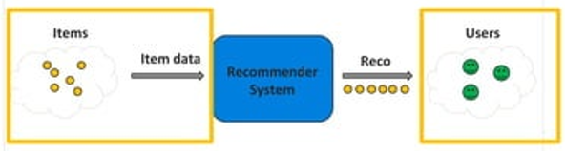
Non-Personalized recommend. System rules-
Items: Entities that are recommended (movies, music, books, news, coupons, restaurants, etc...)
Item data: Descriptive information about the items (e.g. genre, category, price)
Users: People to whom we recommend (Who is the user? Member, cookie, unidentified?)
Paradigm: Recommendations are calculated by predefined non-personalized rules
How: Setting item data-based rules (recommending the latest movies for all users)
Properties:
Non-personalized static recommendations
Requires manual work (e.g editorial pick)
Saturday, June 3, 2023

Slide 22
Classes of recommendation Systems
Recommender Systems
Content-Based Filtering
Information Retrieval Methods
Collaborative Filtering
Model-Based
Co-Clustering, SVD, Neural Networks
Memory-Based
Item-Based
Item-Based k-NN,
Slope One
User-Based
User-Based k-NN
Saturday, June 3, 2023

Slide 23
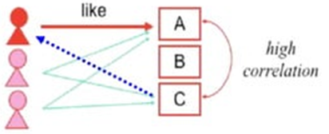
Collaborative Filtering reco. systems?
Collaborative Filtering method finds a subset of users who have similar tastes and preferences to the target user and uses this subset for offering recommendations.
Basic Assumptions:
- Users with similar interests have common preferences about ratings, user likes, and so on.
-A sufficiently large number of user preferences are available.
Main Approaches :
- User Based
- Item Based
Saturday, June 3, 2023

Slide 24
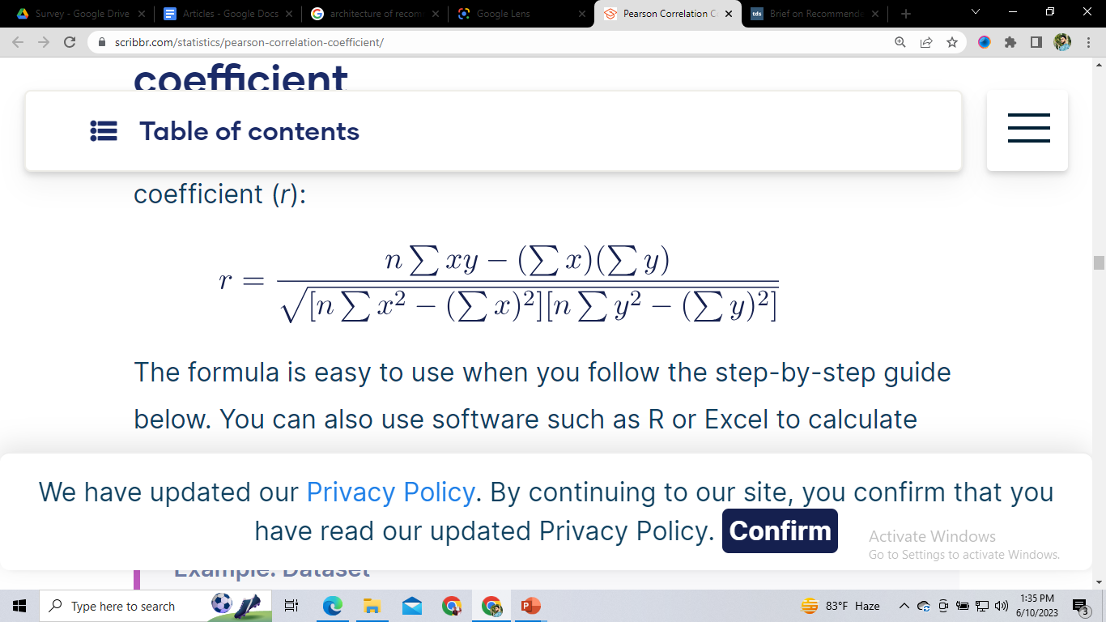
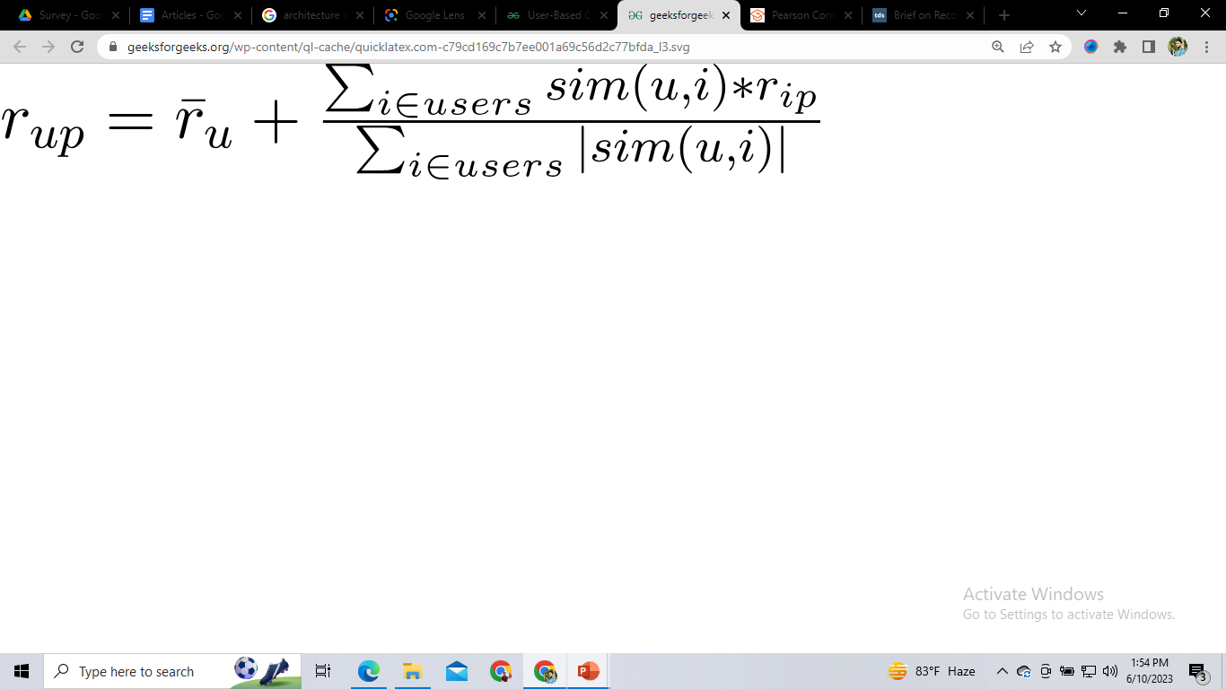
User-Based Collaborative Filtering
- Use user-item rating matrix
- Make user-to-user correlations
- Find highly correlated users
- Recommend items preferred by those users
Pearson Correlation :
Math Solution: https://www.scribbr.com/statistics/pearson-correlation-coefficient/
Prediction Function:
Math Solution: https://www.geeksforgeeks.org/user-based-collaborative-filtering/
Saturday, June 3, 2023

Slide 25
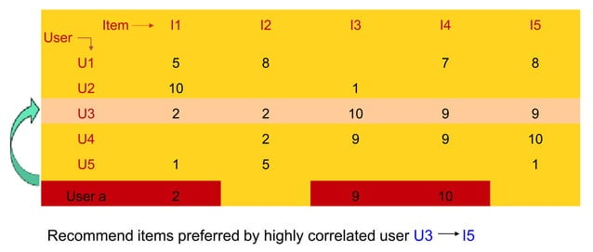
User-Based Collaborative Filtering
Saturday, June 3, 2023

Slide 26
User-Based Collaborative Filtering
Advantage :
- No knowledge about item features needed
Problems:
-New item cold start problem: items with few ratings cannot easily be recommended
- Sparsity problem: If there are many items to be recommended, the user/rating matrix is sparse and it is hard to find the users who have rated the same item.
- Popularity Bias: Tend to recommend only popular items.
Saturday, June 3, 2023

Slide 27
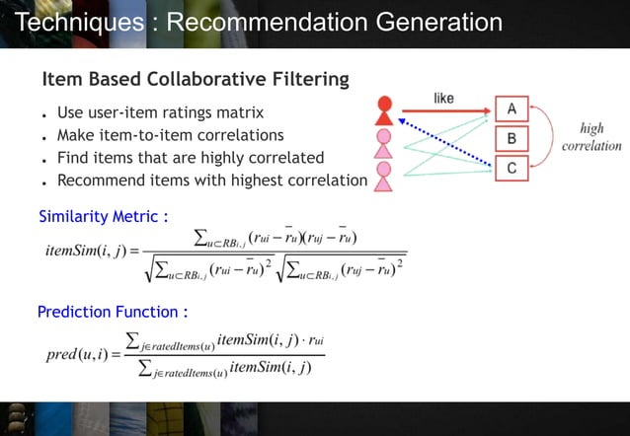
Item-Based Collaborative Filtering
- Use user-item rating matrix
- Make item-to-item correlations
- Find items that are highly correlated
Recommend items with the highest correlation
Similarity Metric:
Prediction Function:
Saturday, June 3, 2023

Slide 28
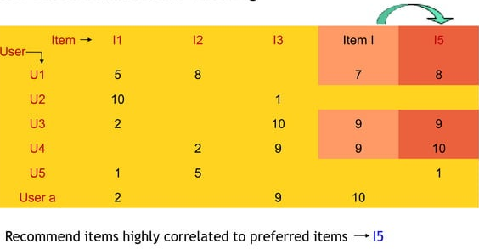
Item-Based Collaborative Filtering
Saturday, June 3, 2023

Slide 29
Item-Based Collaborative Filtering
Advantages:
- No knowledge about item features needed
- Better scalability, because correlations between a limited number of items instead of a very large number of users
Reduced sparsity problem
Problems:
- New user cold start problem
- New item cold start problem
e.g. Amazon, eBay
Saturday, June 3, 2023

Slide 30
Content-based Filtering (CBF)
2. Content Based Systems recommend items similar to those a user has liked (browsed/purchased) in the past. OR
Recommendations are based on the content of items rather than on other users’ opinions.
Characteristics Information: Information about the objects/products such as keywords, categorization, etc.
User Profiles/Fondness: Create user profiles to describe the types of items that the user prefers.
Ex. Movie Recommendation (User1 likes sci-fi, action, and comedy)
Note: Recommendations on the basis of keywords are also classified under content based.
Saturday, June 3, 2023

Slide 31
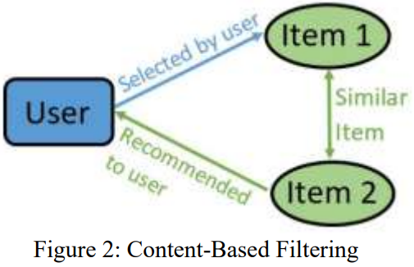
Content-Based System
Advantages:
- No need for data on other users. No cold start and sparsity.
- Able to recommend users with unique tastes.
- Able to recommend new and unpopular items.
- Can provide an explanation for the recommendation.
Limitations:
- Data should be in a structured format.
- Unable to use quality judgments from other users.
Saturday, June 3, 2023

Slide 32
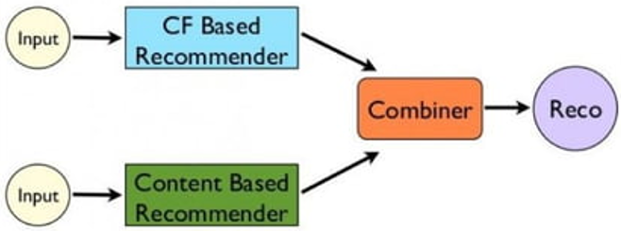
Hybrid recommender system
The hybrid recommendation system is a special type of system that used data of both collaborative data and content-based data simultaneously which helps to suggest a similar or close item to the users.
Ex: Netflix's movies, Spotify's music, Facebook recommending friends, product recommendations of Amazon, etc.
Saturday, June 3, 2023

Slide 33
Other Recommendation techniques
Knowledge-based
Uses extensive domain-specific knowledge to generate recs.
User requirements collected (problem), items as possible solutions to the specific problems
Example: the user would like to find a digital camera, she provides her needs and the level of her skills, etc.
Community-based
Recommendations based on the preferences of the user's friends.
People tend to accept the recommendations of their friends.
Using social networks → social recommender systems.
Hybrid recommendation systems > Combination of the techniques above.
Trying to use the advantages and fix the disadvantages of the different techniques.
Saturday, June 3, 2023

Slide 34
Other Recommendation techniques
Context-Aware Recommendation Systems: Context-aware recommendation systems consider additional contextual information, such as time, location, weather, or user context, to provide personalized recommendations.
Reinforcement Learning-Based Recommendation Systems
Demographic-Based Recommendation Systems
Saturday, June 3, 2023

Slide 35
Memory-Based VS Model-Based
Memory-Based | Model-Based
Uses user ratings to compute the similarity between users or items. Typically uses Similarity (cosine dist., Pearson correlation) Predict a weighted average of ratings Examples k-Nearest Neighbors Slope One + Easy to implement + Explainable results - Scalability issues for sparse data - Slow predictions (has to find similar items/users) | Use given ratings as a training set to fit a model that predicts users’ ratings of unrated items. Typically uses Embedding/dim. Reduction/matrix factors. Machine Learning models to train & predict. Examples Co-Clustering SVD + Scales well with sparse data + ML models can capture more complex relations + Fast prediction + Usually, better predictions than memory-based. - The learning/Training phase required
Saturday, June 3, 2023

Slide 36
Real life applications of Recommendation System
News Websites
Articles Suggest
Social Media Platforms
Linkedin
Facebook friend suggestion
E-Commerce
Amazon.com
Saturday, June 3, 2023

Slide 37
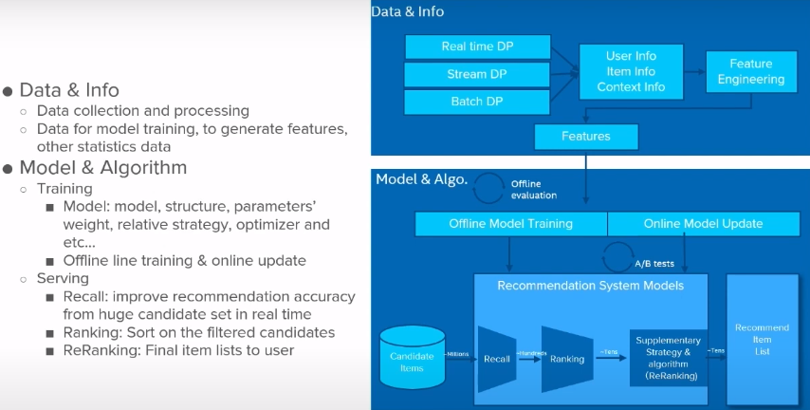
The architecture of recommender system
Saturday, June 3, 2023

Slide 38

Summary
Recommender systems have their origins in a variety of areas of research, including information retrieval, information filtering, text classification, etc. They use techniques such as machine learning and data mining, alongside a range of concepts including algorithms, collaborative and hybrid approaches, and evaluation methods. We are optimistic that in near future research on RS will witness several new and innovative avenues.
Saturday, June 3, 2023

Slide 39


Thank You !

